Slide 1
The birth of menabip
WE TAKE SMALL STEPS, TO ACHIEVE BIG GOALS
www.menabip.org
info@menabip.org
Contact Person:
Azar Tahossein
azar.tahossein@gmail.com

Slide 2
ACHIEVEMENT OF OBJECTIVES
• by holding scientific events.
• through international exchange.
• by publishing a specialist journal.
• by promoting high standards of clinical practice, education and research
in diagnostic and therapeutic interventional pulmonology
including bronchoscopy and thoracoscopy as well as in training and further
education of the endoscopy staff.
• by exchanging of knowledge and experience with relevant national and
international associations.
• by organizing regular meetings in collaboration with various national
and international organizations to support regional conferences,
Symposiums or workshops.

Slide 4
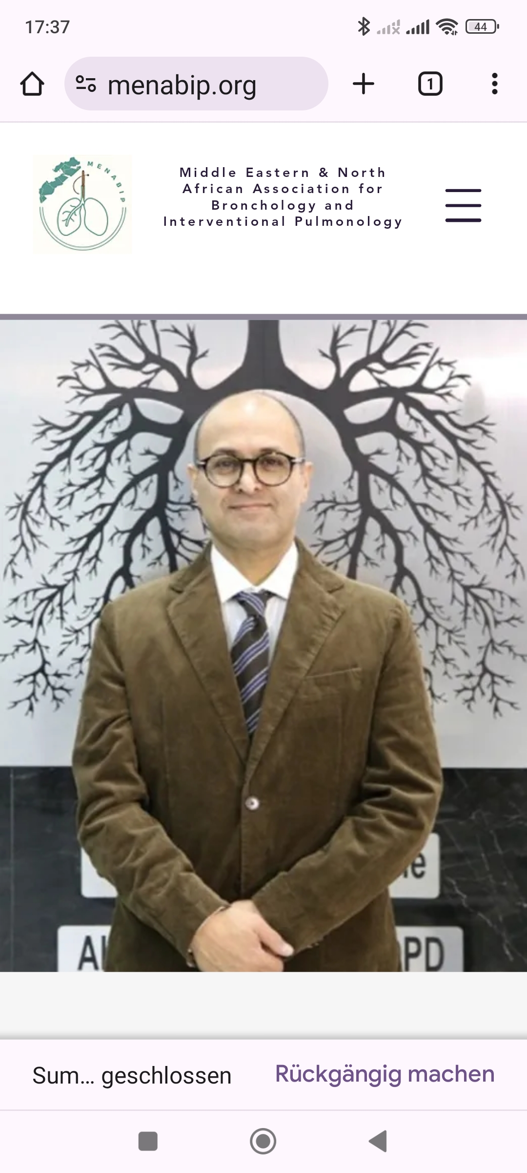
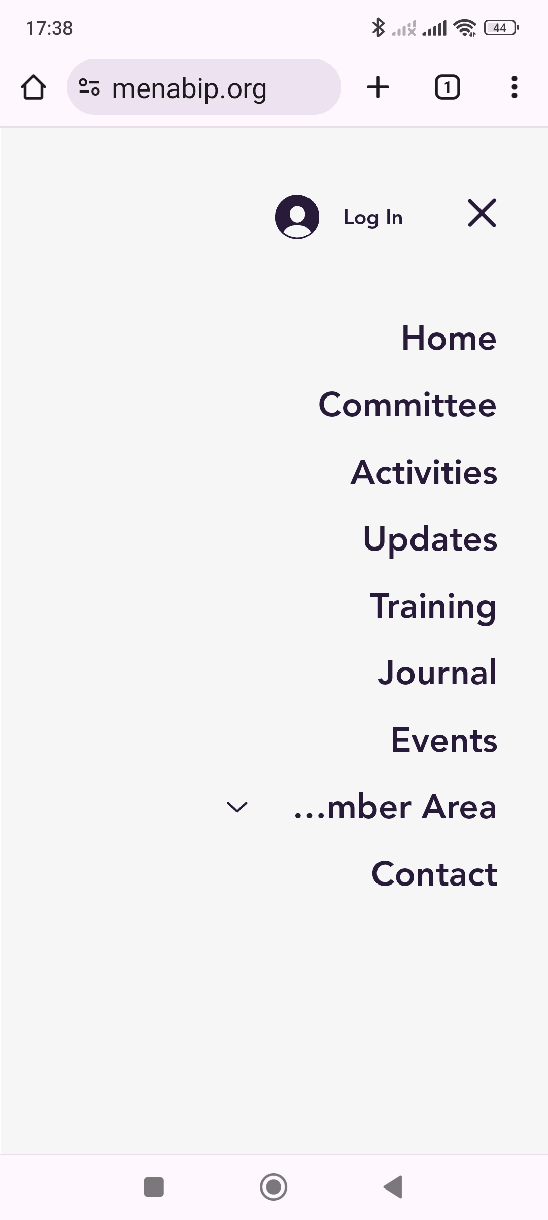
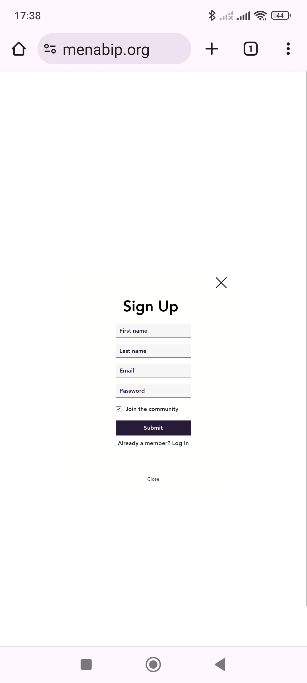
Sign up & Log in via Smartphone

Slide 5
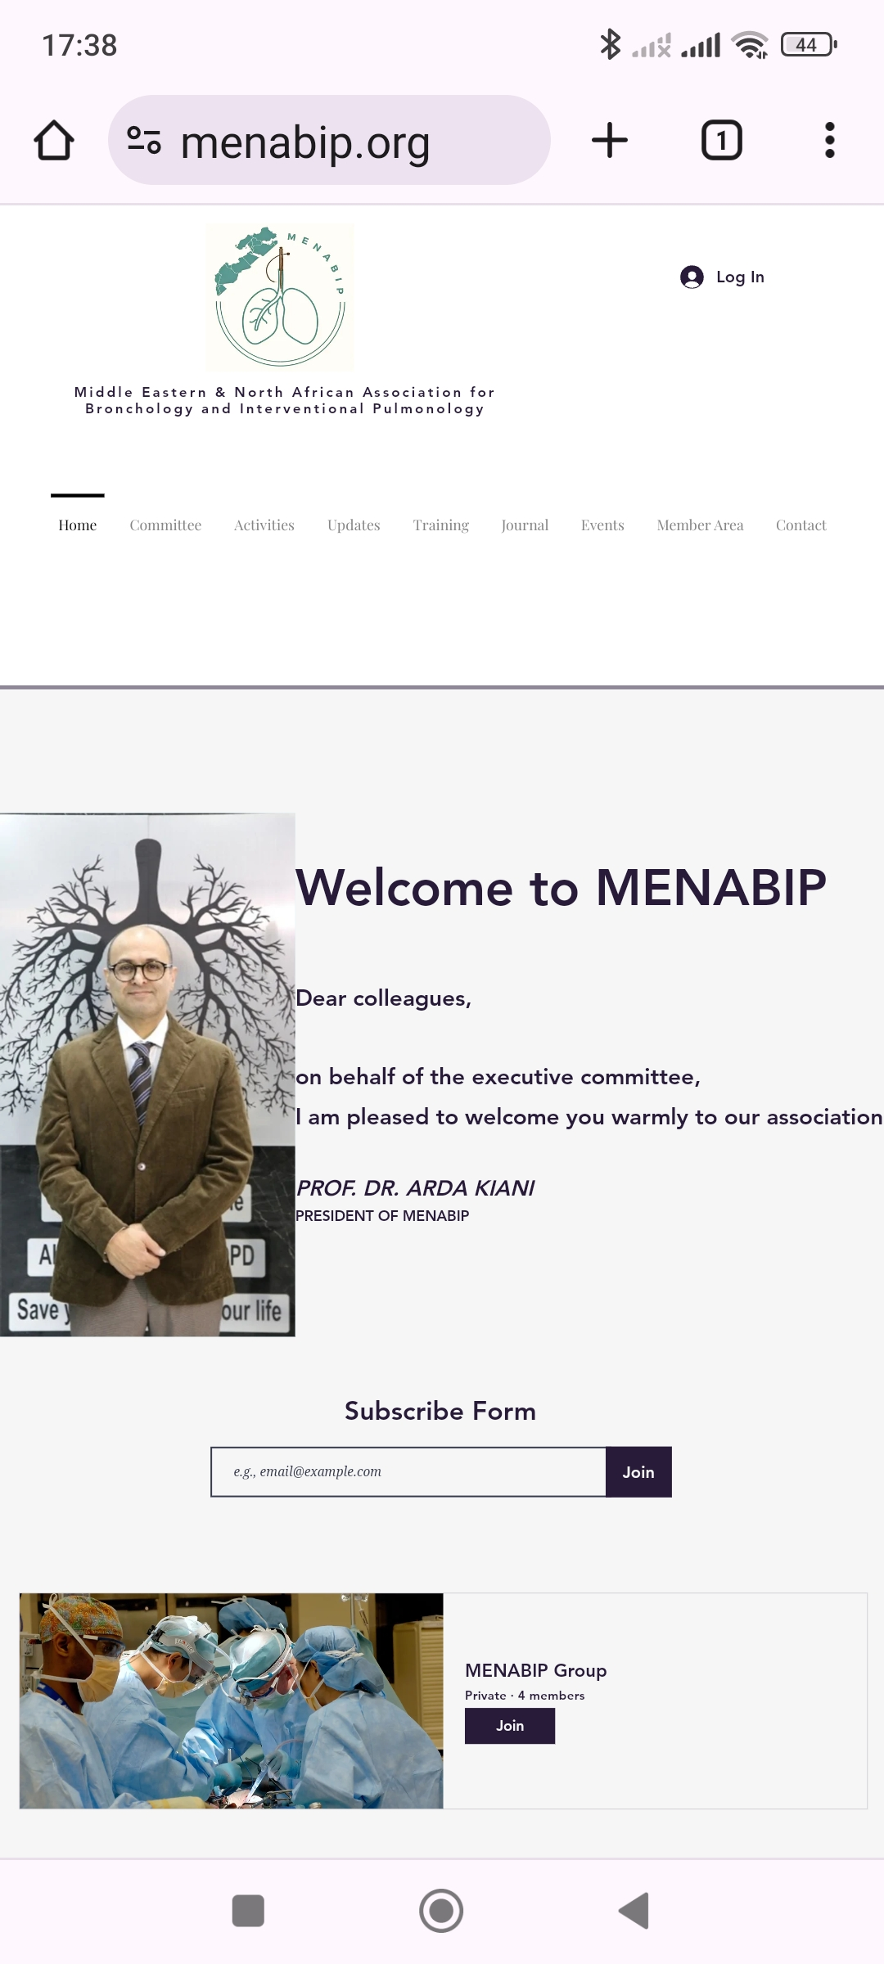
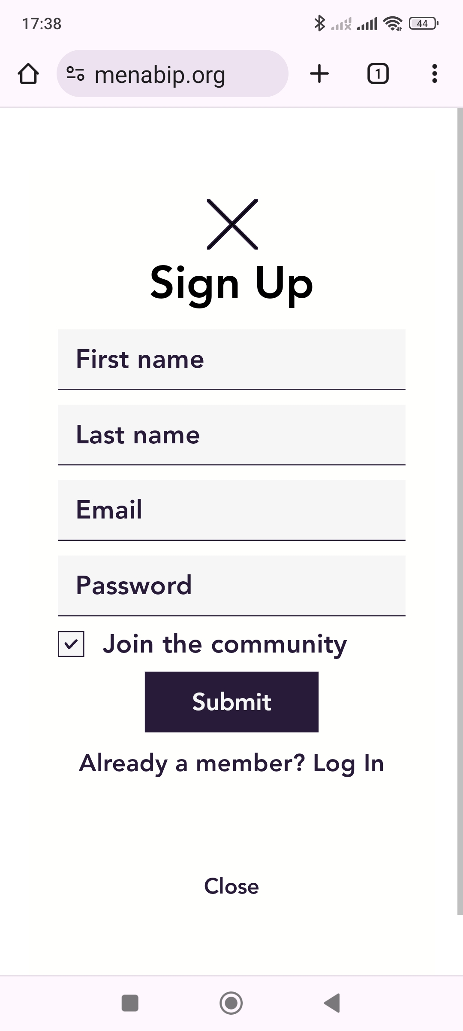
Sign up & Log in via Computer

